Slide 1
Test Case Checklist
A Complete Test Case:
  Case ID: for traceability with requirements
  Test Title: brief purpose of this test case
  Dependency: pre-condition of this test case
  Input Specification: input and their relationship
  Test steps: step by step
  Output Specification: expected output
  Besides these key elements, you can add anything else you think important
Note: this checklist matches IEEE Standard 829 partially

Slide 2
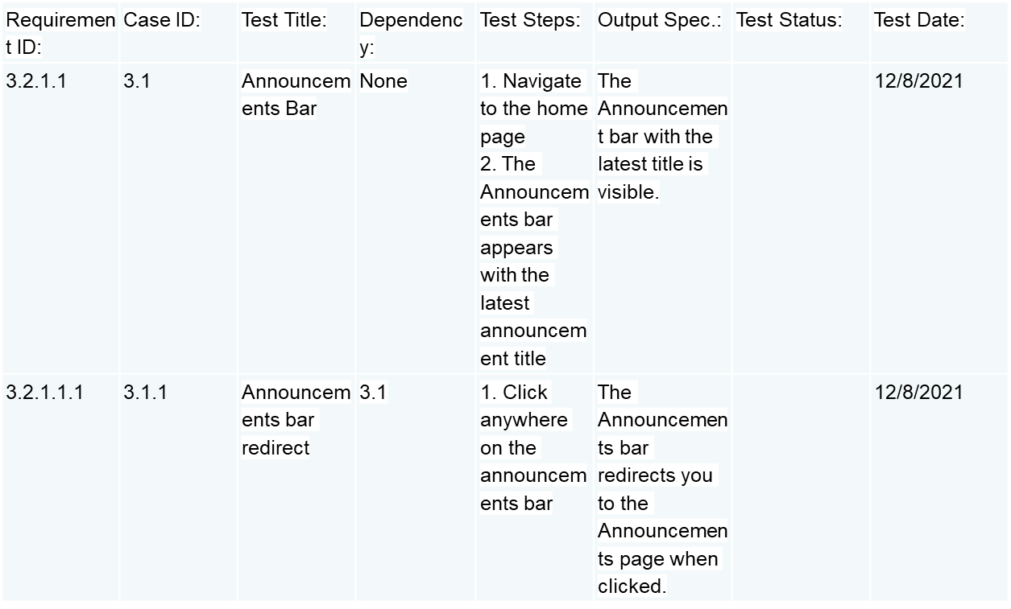
Sample Test Cases
Note: this checklist matches IEEE Standard 829 partially

